Slide 1

INSTITUTE : UIE
DEPARTMENT : CSE
Bachelor of Engineering (Computer Science & Engineering)
PROJECT BASED LEARNING IN JAVA
(20CST-319/20ITT-319)
TOPIC OF PRESENTATION:
Sequence, Dual table , Date type management in Java.
DISCOVER . LEARN . EMPOWER

Slide 2

Lecture Objectives
In this lecture, we will discuss:
Sequence, Dual table , Date type management in Java.

Slide 3
SQL | SEQUENCES
Sequence is a set of integers 1, 2, 3, … that are generated and supported by some database systems to produce unique values on demand.
A sequence is a user defined schema bound object that generates a sequence of numeric values.
Sequences are frequently used in many databases because many applications require each row in a table to contain a unique value and sequences provides an easy way to generate them.
The sequence of numeric values is generated in an ascending or descending order at defined intervals and can be configured to restart when exceeds max_value.

Slide 4
Syntax:
CREATE SEQUENCE sequence_name
START WITH initial_value
INCREMENT BY increment_value
MINVALUE minimum value
MAXVALUE maximum value
CYCLE|NOCYCLE ;
sequence_name: Name of the sequence.
initial_value: starting value from where the sequence starts.
Initial_value should be greater than or equal
to minimum value and less than equal to maximum value.
increment_value: Value by which sequence will increment itself.
Increment_value can be positive or negative.
minimum_value: Minimum value of the sequence.
maximum_value: Maximum value of the sequence.
cycle: When sequence reaches its set_limit
it starts from beginning.
nocycle: An exception will be thrown
if sequence exceeds its max_value.

Slide 5
Example
Following is the sequence query creating sequence in ascending order.
Example 1:
CREATE SEQUENCE sequence_1
start with 1
increment by 1
minvalue 0
maxvalue 100
cycle;
Above query will create a sequence named sequence_1.Sequence will start from 1 and will be incremented by 1 having maximum value 100. Sequence will repeat itself from start value after exceeding 100.

Slide 6
Example
Following is the sequence query creating sequence in descending order.
CREATE SEQUENCE sequence_2
start with 100
increment by -1
minvalue 1
maxvalue 100
cycle;
Above query will create a sequence named sequence_2.Sequence will start from 100 and should be less than or equal to maximum value and will be incremented by -1 having minimum value 1.

Slide 7
Dual Table
What is DUAL table?
The DUAL is special one row, one column table present by default in all Oracle databases.
The owner of DUAL is SYS (SYS owns the data dictionary, therefore DUAL is part of the data dictionary.) but DUAL can be accessed by every user.
The table has a single VARCHAR2(1) column called DUMMY that has a value of 'X'.
MySQL allows DUAL to be specified as a table in queries that do not need data from any tables. In SQL Server DUAL table does not exist, but you could create one.

Slide 8
Dual Table Example
The DUAL table was created by Charles Weiss of Oracle corporation to provide a table for joining in internal views.
See the following commands :
The following command displays the structure of DUAL table :
DESC DUAL;
Output:
Name Null? Type
--------------------------- ------
DUMMY VARCHAR2(1)
The following command displays the content of the DUAL table :
SELECT * FROM DUAL;
Output:
DUMMY
----------
X

Slide 9
The following command displays the number of rows of DUAL table :
SELECT COUNT(*) FROM DUAL;
Output:
COUNT(*)
----------
1
The following command displays the string value from the DUAL table :
SELECT 'ABCDEF12345' FROM DUAL;
Output:
'ABCDEF1234
-----------
ABCDEF12345

Slide 10
The following command displays the numeric value from the DUAL table :
SELECT 123792.52 FROM DUAL;
Output:
123792.52
----------
123792.52
The following command tries to delete all rows from the DUAL table :
DELETE FROM DUAL;
Output:
DELETE FROM DUAL
*
ERROR at line 1:
ORA-01031: insufficient privileges

Slide 11
The following command tries to remove all rows from the DUAL table :
TRUNCATE TABLE DUAL;
Note : The DELETE command is used to remove rows from a table. After performing a DELETE operation you need to COMMIT or ROLLBACK the transaction to make the change permanent or to undo it. TRUNCATE removes all rows from a table. The operation cannot be rolled back.
Output:
TRUNCATE TABLE DUAL
*
ERROR at line 1:
ORA-00942: table or view does not exist

Slide 12
The following command select two rows from dual :
SELECT dummy FROM DUAL
UNION ALL
SELECT dummy FROM DUAL;
Output
DUMMY
----------
X
X

Slide 13

DUAL table : Oracle vs MySQL
We have already learned that DUAL is a special one row one column table. For Oracle, it is useful because Oracle doesn't allow statements like :
SELECT 15+10-5*5/5;
Output:
SELECT 15+10-5*5/5
*
ERROR at line 1:
ORA-00923: FROM keyword not found where expected
But the following command will execute (see the output of the previous example) :
SELECT 15+10-5*5/5 FROM DUAL;
In case of MySQL the following command will execute :
SELECT 15+10-5*5/5;
Output:

Slide 14
Using basic data types
The Microsoft JDBC Driver for SQL Server uses the JDBC basic data types to convert the SQL Server data types to a format that can be understood by the Java programming language, and vice versa.
The JDBC driver provides support for the JDBC 4.0 API, which includes the SQLXML data type, and National (Unicode) data types, such as NCHAR, NVARCHAR, LONGNVARCHAR, and NCLOB.

Slide 15
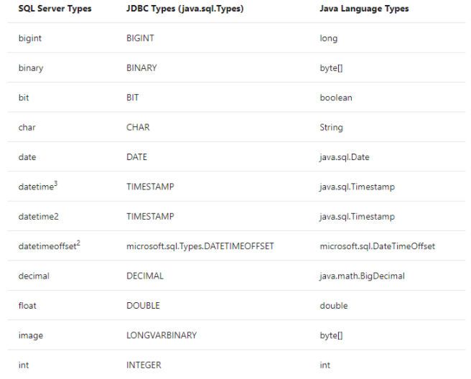
Data type mappings
The following table lists the default mappings between the basic SQL Server, JDBC, and Java programming language data types:

Slide 16
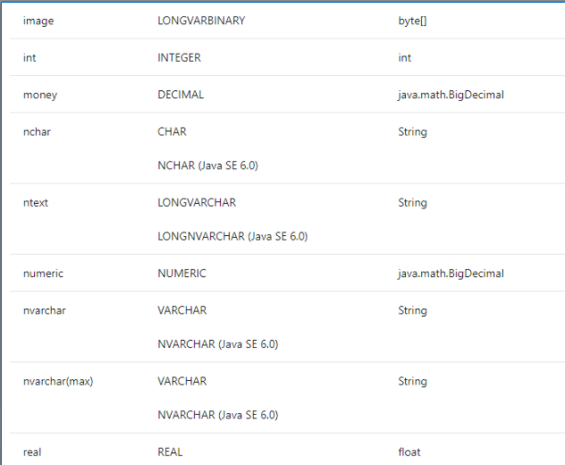

Slide 17
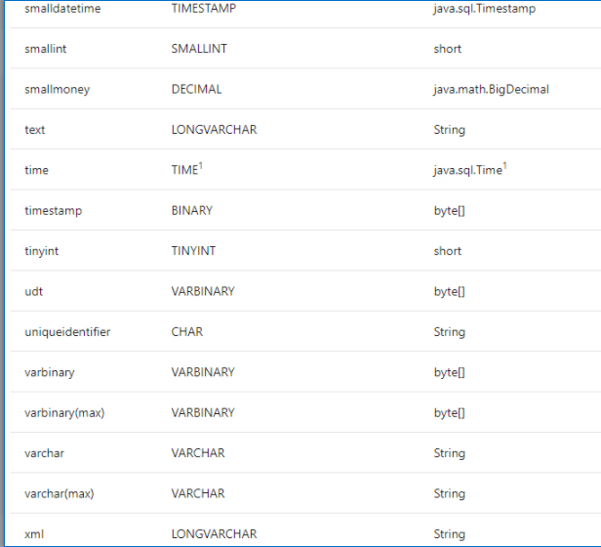

Slide 18
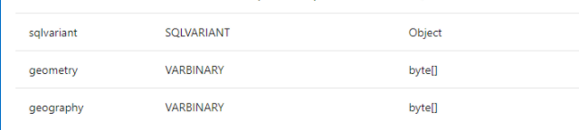
1 To use java.sql.Time with the time SQL Server type, you must set the sendTimeAsDatetime connection property to false.
2 You can programmatically access values of datetimeoffset with DateTimeOffset Class.
3 Note that java.sql.Timestamp values can no longer be used to compare values from a datetime column starting from SQL Server 2016. This limitation is due to a server-side change that converts datetime to datetime2 differently, resulting in non-equitable values. The workaround to this issue is to either change datetime columns to datetime2(3), use String instead of java.sql.Timestamp, or change database compatibility level to 120 or below.

Slide 19
Retrieving data as a string
Retrieving data by data type
Updating data by data type
Updating data by parameterized query
Passing parameters to a stored procedure
Retrieving parameters from a stored procedure

Slide 20
Summary:
In this session, you were able to :
Learn about Sequence, Dual table , Date type management in Java.

Slide 21
References:
Books:
1. Balaguruswamy, Java.
2. A Primer, E.Balaguruswamy, Programming with Java, Tata McGraw Hill Companies
3. John P. Flynt Thomson, Java Programming.
Reference Links:
https://www.geeksforgeeks.org/sql-sequences/
https://www.tutorialspoint.com/sql/sql-using-sequences.htm
https://docs.oracle.com/cd/B28359_01/server.111/b28286/statements_6015.htm
https://www.w3resource.com/sql/sql-dual-table.php
https://www.geeksforgeeks.org/dual-table-in-sql/
Video Links:
https://youtu.be/zADj0k0waFY
https://youtu.be/SO_wA88hpPs

Slide 22
THANK YOU

